Slide 1
Computing for the Endless Frontier Software Challenges
Dan Stanzione
Executive Director, Texas Advanced Computing Center
Associate Vice President for Research, UT-Austin
Software Challenges for Exascale Computing
December 2018

Slide 2
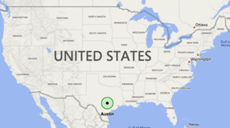
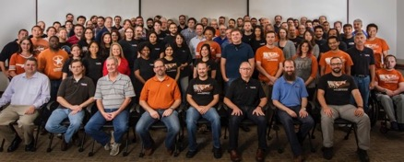
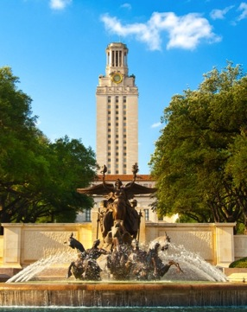
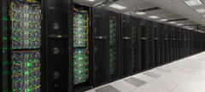
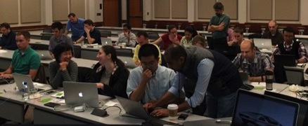
TACC AT A GLANCE
Personnel
160 Staff (~70 PhD)
Facilities
12 MW Data center capacity
Two office buildings, Three Datacenters, two visualization facilities, and a chilling plant.
Systems and Services
Two Billion compute hours per year
5 Billion files, 75 Petabytes of Data, Hundreds of Public Datasets
Capacity & Services
HPC, HTC, Visualization, Large scale data storage, Cloud computing
Consulting, Curation and analysis, Code optimization, Portals and Gateways, Web service APIs, Training and Outreach

Slide 3
Frontera System --- Project
A new, NSF supported project to do 3 things:
Deploy a system in 2019 for the largest problems scientists and engineers currently face.
Support and operate this system for 5 years.
Plan a potential phase 2 system, with 10x the capabilities, for the future challenges scientists will face.

Slide 4
Frontera System --- Hardware
Primary compute system: DellEMC and Intel
35-40 PetaFlops Peak Performance
Interconnect: Mellanox HDR and HDR-100 links.
Fat Tree topology, 200Gb/s links between switches.
Storage: DataDirect Networks
50+ PB disk, 3PB of Flash, 1.5TB/sec peak I/O rate.
Single Precision Compute Subsystem: Nvidia
Front end for data movers, workflow, API

Slide 5
Design Decisions - Processor
The architecture is in many ways “boring” if you are an HPC journalist, architect, or general junkie.
We have found that the way users refer to this kind of configuration is “useful”.
No one has to recode for higher clock rate. We have abandoned the normal “HPC SKUS” of Xeon, in favor of the Platinum top bin parts – the ones that are 205W per socket.
Which, coincidentally, means the clock rate is higher on every core, whether you can scale in parallel or not.
Users tend to consider power efficiency “our problem”.
This also means there is *no* air cooled way to run these chips.
Versus Stampede2, we are pushing up clock rate, core count, and main memory speed.
This is as close to “free” performance as we can give you.

Slide 6
Design Decisions - Filesystem
Scalable Filesystems are always the weakest part of the system.
Almost the only part of the system where bad behavior by one user can affect the performance of a *different* user.
Filesystems are built for the aggregate user demand – rarely does one user stress *all* the dimensions of filesystems (Bandwidth, Capacity, IOPS, etc.)
We will divide the ”scratch” filesystem into 4 pieces
One with very high bandwidth
3 at about the same scale as Stampede, and divide the users.
Much more aggregate capability – but no need to push scaling past ranges at which we have already been successful.
Expect higher reliability from perspective of individual users
Everything POSIX, no “exotic” things from user perspective.

Slide 7
Original System Overview
>38PF Dbl Precision
>8,000 Xeon Nodes
>8PF Single Precision

Slide 8
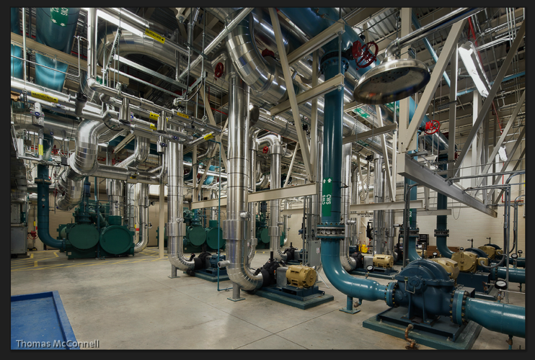
Frontera System --- Infrastructure
Frontera will consume almost 6 Megawatts of Power at Peak
Direct water cooling of primary compute racks (CoolIT/DellEMC)
Oil immersion Cooling (GRC)
Solar, Wind inputs.
TACC Machine Room Chilled Water Plant

Slide 9
The TEAM - Institutions
Operations: TACC, Ohio State University (MPI/Network support), Cornell (Online Training), Texas A&M (Campus Bridging)
Science and Technology Drivers and Phase 2 Planning: Cal Tech, University of Chicago, Cornell, UC-Davis, Georgia Tech, Princeton, Stanford, Utah
Vendors: DellEMC, Intel, Mellanox, DataDirect Networks, GRC, CoolIT, Amazon, Microsoft, Google

Slide 10
System Support Activities The “Traditional”
Stuff you always expect from us:
Extended Collaborative Support (under of course yet another name) from experts in HPC, Vis, Data, AI, Life Sciences, etc.
Online and in person training, online documentation.
Ticket support, 24x7 staffing
Comprehensive SW stack – the usual ~2,000 RPMs.
Archive access – scalable to an Exabyte.
Shared Work Filesystem – same space across the ecosystem.
Queues for very large and very long – plus small and short, and backfill tuned so that works OK.
Reservations and priority tuning to give Quality of Service guarantees when needed.

Slide 11
System Support Activities The “Traditional”
Stuff that is slightly newer (but you should still start to expect from us) :
Auto-tuned MPI stacks
Automated Performance Monitoring, with data mining to drive consulting
Slack channels for user support (it’s a much smaller user community).

Slide 12
New System Support Activities
Full Containerization support (this platform, Stampede, and *every other* platform now and future.
Support for Controlled Unclassified Information (i.e. Protected Data)
Application servers for persistent VMs to support services for automation.
Data Transfer (ie. Globus)
Our native REST APIs
Other service APIs as needed – OSG (for Atlas, CMS, LIGO)
Possibly other services (Pegasus, perhaps things like metagenomics workflows)

Slide 13
New System Support Activities
Built on these services, Portal/Gateway support
Close collaboration at TACC with SGCI (led by SDSC).
“Default” Frontera portals for: (not all in year 1).
Job submission, workflow building, status, etc.
Data Management – not just in/out and on the system itself, but full lifecycle – archive/collections system/cloud migration, metadata management, publishing and DOIs.
Geospatial
ML/AI Application services.
Vis/Analytics
Interactive/Jupyter
And, of course, support to roll your own, or get existing community ones integrated properly.

Slide 14
Phase 2 Prototypes
Allocations will include access to testbed systems with future/alternative architectures
Some at TACC, e.g. FPGA systems, Optane NVDIMM, {as yet unnamed 2021, 2023}.
Some with partners – a Quantum Simulator at Stanford.
Some with the commercial cloud – Tensor Processors, etc.
Fifty nodes with Intel Optane technology will be deployed next year in conjunction with the production system
Checkpoint file system? Local checkpoints to tolerate soft failures? Replace large memory nodes? Revive ”out of core” computing? In-memory databases?
Any resulting phase 2 system is going to be the result, at least in part, of actual users measured on actual systems, including at looking at, what they might actually *want* to run on.
Eval around the world – keep close tabs on what is happening elsewhere (sometimes by formal partnership or exchange – ANL, ORNL, China, Europe).

Slide 15
Strategic Partnership with Commercial Clouds
Cloud/HPC is *not* an either/or. (And in many ways, we are just a specialized cloud).
Utilize cloud strengths:
Options for publishing/sustaining data and data services
Access to unique services in automated workflow; VDI (i.e. image tagging, NLP, who knows what. . . )
Limited access to *every* new node technology for evaluation
FPGA, Tensor, Quantum, Neuromorphic, GPU, etc.
We will explore some bursting tech for more “throughput” style jobs – but I think the first 3 bullets are much more important. . .

Slide 16
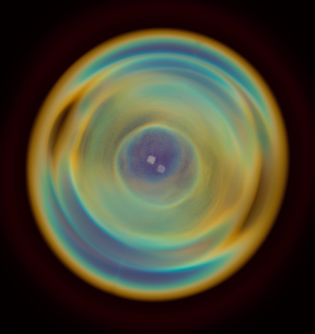
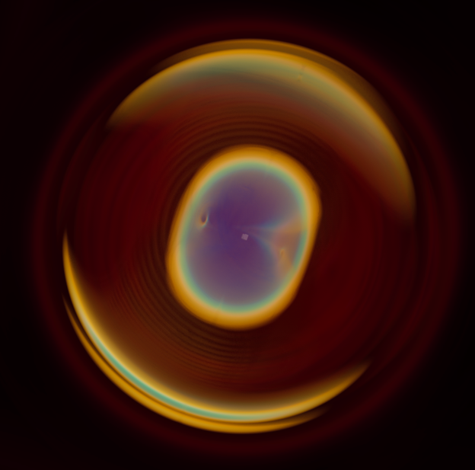
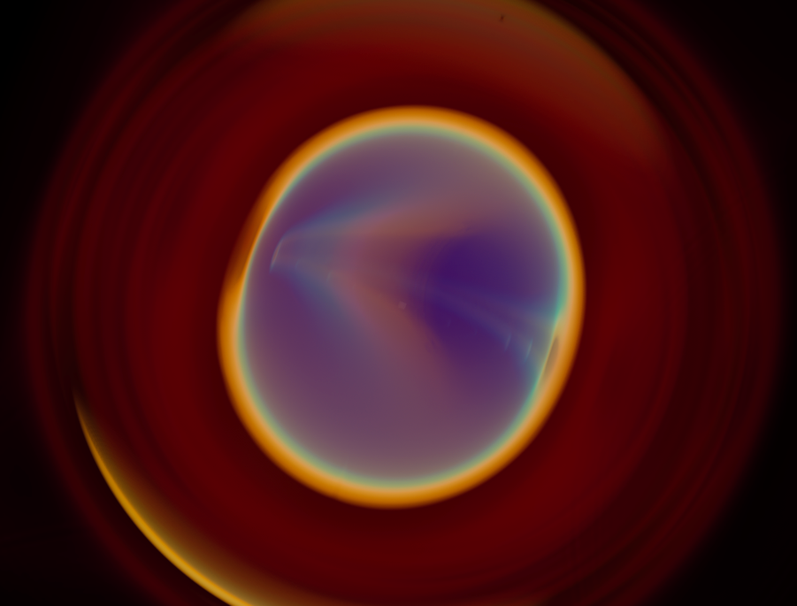
COSMOS Gravitational Waves study
Image Credits:
Greg Abram – TACC
Francesca Samsel – CAT
Carson Brownlee - Intel
Markus Kunesch, Juha Jäykkä, Pau Figueras, Paul Shellard
Center for Theoretical Cosmology, University of Cambridge

Slide 17
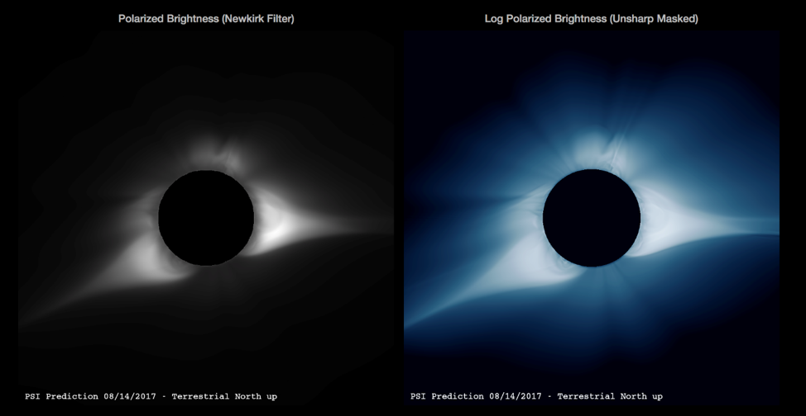
SOLAR Corona prediction
Predictive Science, Inc. (California)
Supporting NASA Solar Dynamics Observatory (SDO)
Predicted solar corona on S2 during 8/21/17 eclipse
Notes:
PREDSSCI works in support of NASA and AFOSR missions.

Slide 18
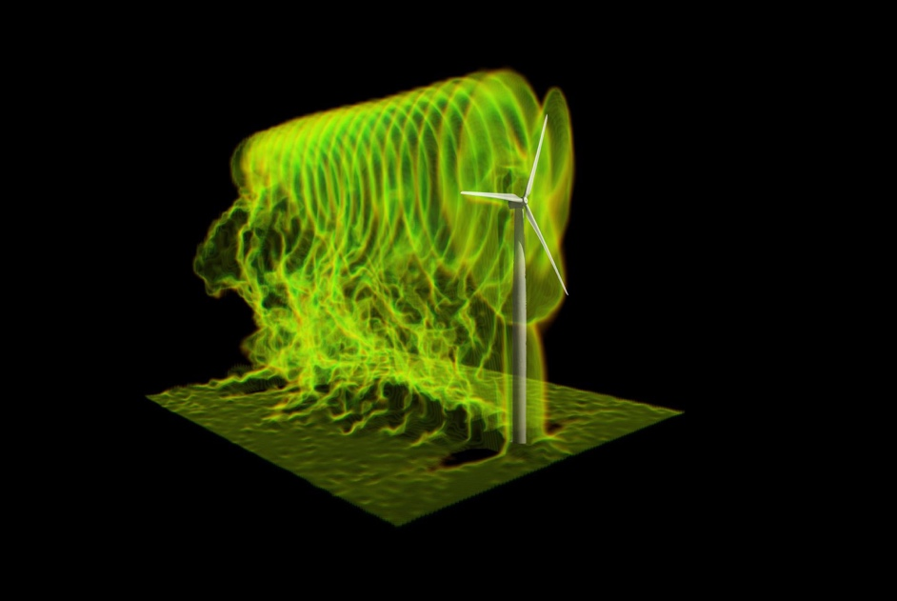
Reaping Power from Wind Farms
Multi-Scale Model of Wind Turbines
Optimized control algorithm improves design choices
New high-res models add nacelle and tower effects
Blind comparisons to wind tunnel data demonstrate dramatic improvements in accuracy
Potential to increase power by 6-7% ($600m/yr nationwide)
“TACC...give[s] us a competitive advantage…”
Graphic from Wind Energy, 2017.
Christian Santoni, Kenneth Carrasquillo,
Isnardo Arenas‐Navarro, and Stefano Leonardi
UT Dallas, US/European collaboration (UTRC, NSF-PIRE 1243482)
TACC Press Release
Notes:
Xxxxx Speaking notes here xxxxx

Slide 19
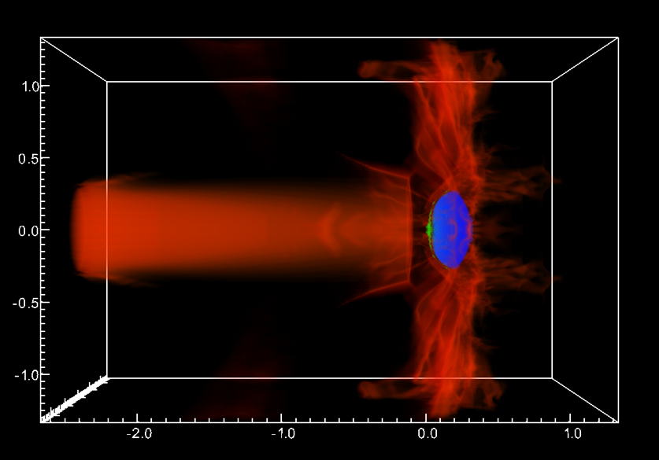
Using KNL to Probe Space Oddities
Graphic here.
Use this box as background frame.
Ongoing XSEDE collaboration focusing on KNL performance for new, high-resolution version of COSMOS MHD code
Vectorization and other serial optimizations improved KNL performance by 50%
COSMOS currently running 60% faster on KNL than Stampede1
Work on OpenMP-MPI hybrid optimizations now underway
Impact of performance improvements amounts to millions of core-hours saved
"The science that I do wouldn't be possible without resources like [Stampede2]...resources that certainly a small institution like mine could never support. The fact that we have these national-level resources enables a huge amount of science that just wouldn't get done otherwise." (Chris Fragile)
XSEDE ECSS: Collaboration between PI Chris Fragile (College of Charleston) and Damon McDougall (TACC)
TACC Press Release
Notes:
Xxxxx Speaking notes here xxxxx

Slide 20
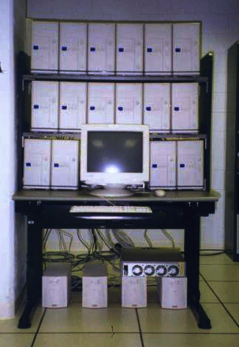
HPC Has Evolved. . .

Slide 21
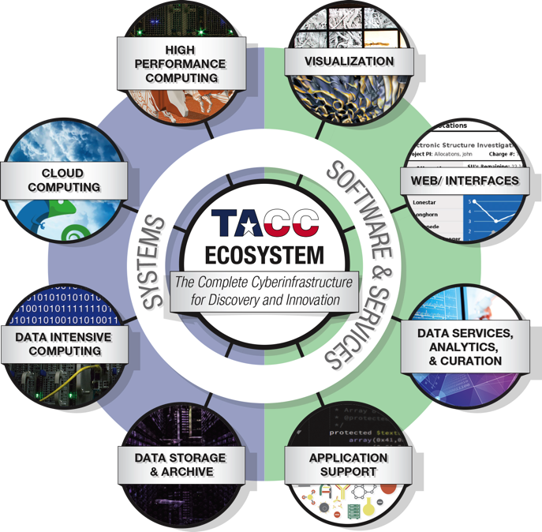
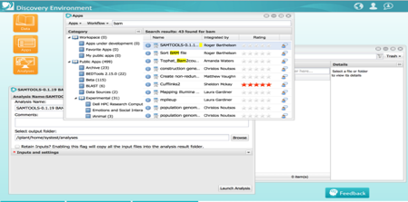
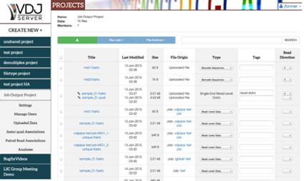
Supporting an evolving Cyberinfrastructure
Success in Computational/Data Intensive Science and Engineering takes more than systems.
Modern Cyberinfrastructure requires many modes of computing, many skillsets, and many parts of the scientific workflow.
Data lifecycle, reproducibility, sharing and collaboration, event driven processing, APIs, etc.
Our team and software investments are larger than our system investments
Advanced Intefaces – Web front ends, Rest API, Vis/VR/AR
Algorithms – Partnerships with ICES @ UT to shape future systems, applications and libraries.

Slide 22
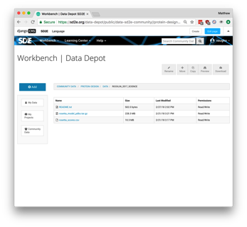
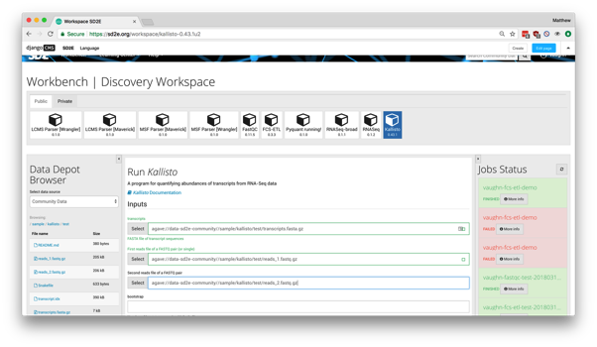
HPC Doesn’t Look Like it used to. . .
HPC-Enabled Jupyter Notebooks
Narrative analytics and exploration environment
Web Portal
Data management and accessible batch computing
Event-driven Data Processing
Extensible end-to-end framework to integrate planning, experimentation, validation and analytics
From Batch Processing and single simulations of many MPI Tasks – to that, plus new modes of computing, automated workflows, users who avoid the command line, reproducibility and data reuse, collaboration, end-to-end data management,
Simulation where we have models
Machine Learning where we have data or incomplete models
And most things are a blend of most of these. . .

Slide 23
An ExEmplar project – SD2E
DARPA – “Synergistic Discovery and Design (SD2)”
Vision: to "develop data-driven methods to accelerate scientific discovery and robust design in domains that lack complete models."
Initial focus in synthetic biology; ~six data provider teams, ~15 modeling teams, TACC for platform
Cloud-based tools to collect, integrate, and analyze diverse data types; Promote collaboration and interaction across computational skill levels; Enable a reproducible and explainable research computing lifecycle; Enhance, amplify, and link the capabilities of every SD2 performer

Slide 24
Harvey
Next Generation Storm Forecasting (with Penn State)
Storm Surge Modeling (with Clint Dawson UT Austin)
Preliminary river flooding and inundation maps (David Maidment UT Austin)
Remote Image Integration and Assimilation (Center for Space Research, UT Austin)

Slide 25
Brain Tumor Segmentation
A team of researchers led by George Biros from The University of Texas at Austin scored in the top 25% of participants in the Multimodal Brain Tumor Segmentation Challenge 2017 (BRaTS'17) enabled by Stampede2 and other TACC resources.
In the challenge, research groups presented methods and results of computer-aided identification and classification of brain tumors, as well as different types of cancerous regions.
The team's method combined biophysical models of tumor growth with machine learning algorithms for the analysis of Magnetic Resonance imaging data of glioma patients.

Slide 26
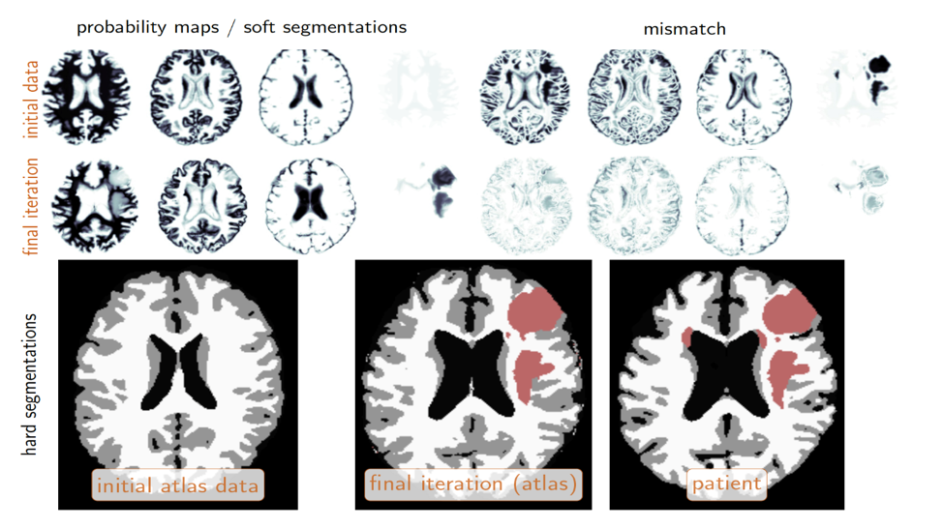

Slide 27
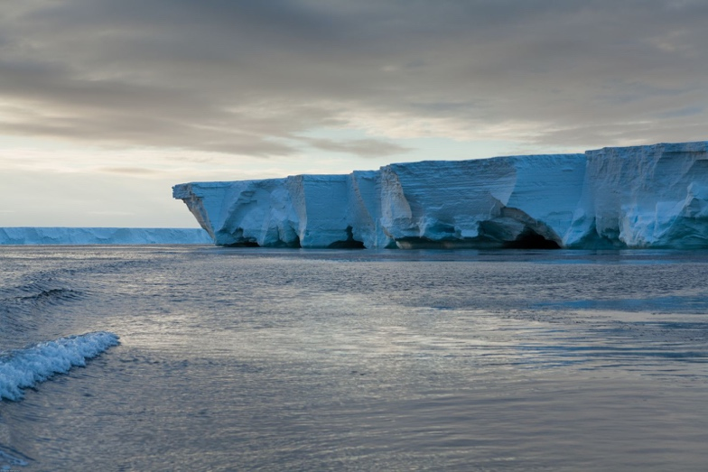
Massive Data Set Worthy of Ross Ice Shelf Itself
Graphic here.
frame.
TACC partners with Lamont-Doherty Earth Observatory (LDEO) to host for one of the country’s largest earth sciences data collections
Managing hundreds of TB using Stampede2, Corral, and Ranch: storage, provenance, visualization, and public access
Achieved 10x workflow speedup by moving to TACC (from 50 hrs down to 5 hrs for transfer and analysis tasks)
“...partnership...with TACC shows [it’s] possible to manage…this level of data in a cost-effective, user-friendly and easily accessible manner…”
Image courtesy Oceanwide Expeditions.
TACC Press Release
PI Lingling Dong, Columbia University
XSEDE support to multidisciplinary, multi-institutional Rosetta project
Notes:
Xxxxx Speaking notes here xxxxx

Slide 28
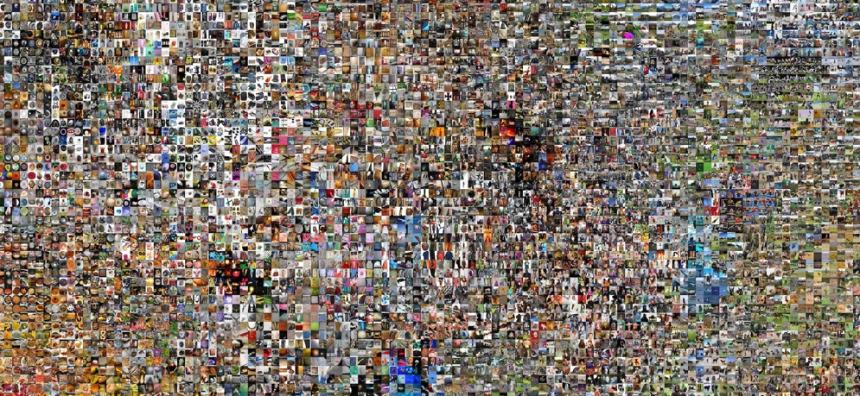
Record Achieved on AI Benchmark
"Using commodity HPC servers...the time to data-driven discovery is reduced and overall efficiency can be significantly increased." (Niall Gaffney, TACC)
Graphic credit Andrej Karpathy
TACC, Berkeley, Cal Davis collaborate
on large-scale AI runs
Graphic here.
Use this box as background frame.
Research demonstrating the potential of commodity hardware for AI
Skylake ImageNet benchmark: (100 epochs, 11 min, 1024 nodes) -- fastest result at time of publication
Knights Landing ImageNet benchmark (90 epochs, 20 min, 2048 nodes) – 3x faster than Facebook, with higher large-batch accuracy
Yang You, Zhao Zhang, Cho-Jui Hsieh, James Demmel, Kurt Keutzer
TACC Press Release
Notes:
Xxxxx Speaking notes here xxxxx

Slide 29
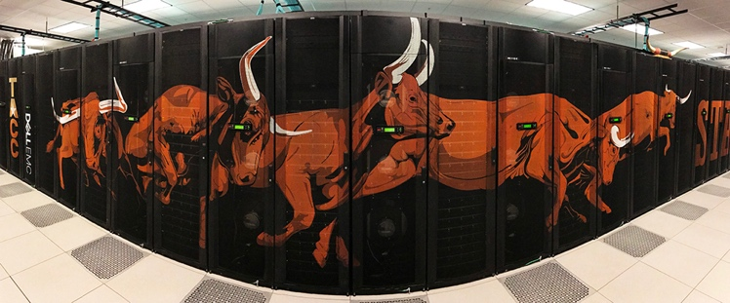
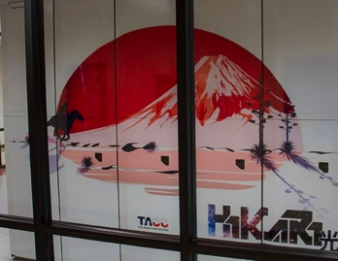
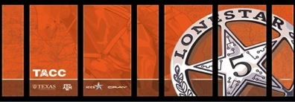
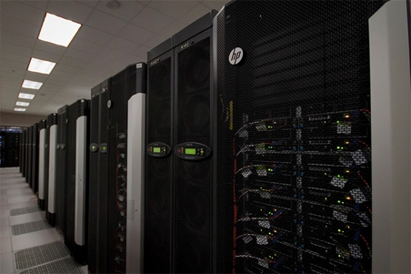
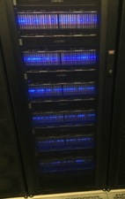
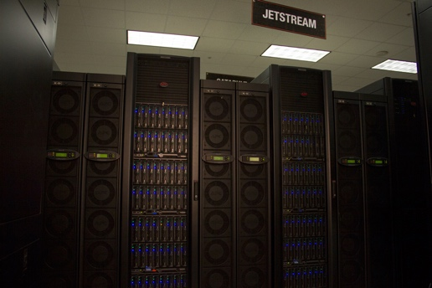
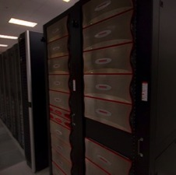
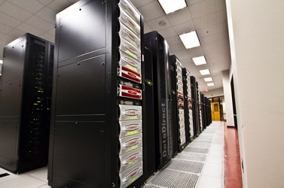
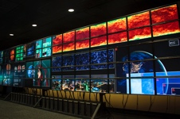
An ecosystem for Extreme Scale Supercomputing
Stampede-2
#12 HPC system,18PF, 350k cores
Lonestar 5
Texas-focused HPC/HTC XC40 30,000 Intel Haswell cores 1.25 PF
Hikari
Protected Data
Containers
10,000 Intel Haswell cores 400TF
Maverick2
GPU/Interactive/Analytics
GeForce GPUs, Jupyter and interactive support
Wrangler
Data Intensive Computing
0.6 PB flash storage 1 TB/s read rate
Jetstream
w/ Indiana U.
Science Cloud/HTC
VM Library
~10,000 Intel Haswell cores
Ranch
Archive
HIPAA-Aligned
30PB Disk Cache,
0.5EB Tape
Stockyard
Shared Storage Across TACC
30PB, Lustre
Corral
Published Data Collections
HIPAA-Aligned
20PB Replicated Disk,
Rodeo
Lasso
Notes:
Talk a little about what we mean by BIG INNOVATIVE SYSTEMS
Then, spend the rest of my time talking about how we are HELPING PEOPLE GO FAST
Cloud systems weave all this together
We also have testbed systems online or coming in next 6 mo
Altera FPGA, POWER/NVIDIA, HP APOLLO powered by solar HVDC

Slide 30
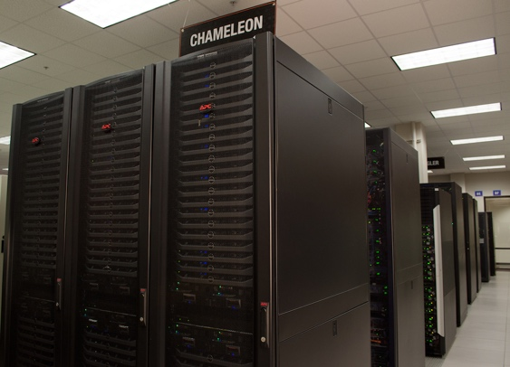
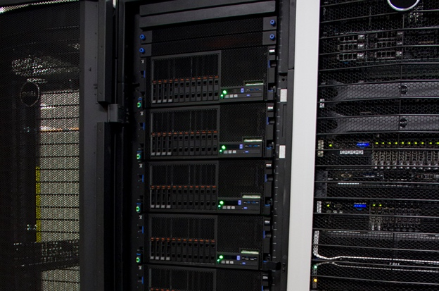
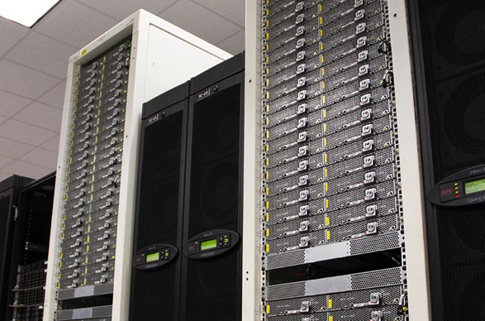
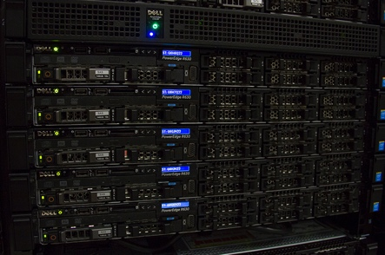
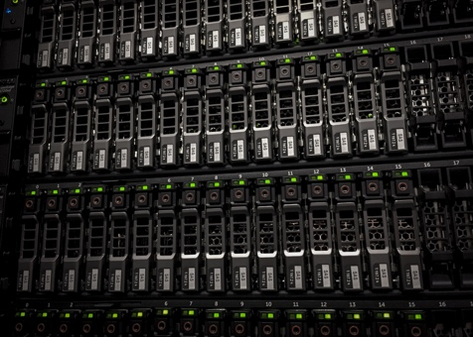
Experimental Systems
Chameleon
w/U. Chicago/Argonne
Computer Science Testbed
Fabric
Alternate Architectures
(IBM,CAPI,FPGA, GPU)
Catapult
Altera FPGA Testbed
(Microsoft)
Discovery
New Processor/Storage
Benchmarking
Rustler
Object Storage Testbed
Notes:
Talk a little about what we mean by BIG INNOVATIVE SYSTEMS
Then, spend the rest of my time talking about how we are HELPING PEOPLE GO FAST
Cloud systems weave all this together
We also have testbed systems online or coming in next 6 mo
Altera FPGA, POWER/NVIDIA, HP APOLLO powered by solar HVDC

Slide 31
So what does all this mean for software?
The basic way to program for Frontera is MPI+OpenMP
At 10k, 100k, 500k cores, the “end of MPI” has been predicted.
It has been consistently wrong, and probably still is.
Arguably, in the last 60 years, our scientific programming successes are:
C/Fortran
MPI
OpenMP
Python? CUDA?
We have tens of thousands of failures (any Chapel or X10 apps running at scale?).
At this point, our system designs are being driven by ”users can’t change”. (or at least not effectively).

Slide 32
Yet, things have changed
The “core” exascale apps will likely still be C/C++ or Fortran with MPI+X.
X is overwhelmingly likely to be either OpenMP5 or CUDA.
But there are many, many other apps that in aggregate will consume many cycles at Exascale
Will *any* of the main DL/ML/AI frameworks be C+MPI/OpenMP???
Will the data frameworks? We have 10s of Zettabytes of data to process on Exaflop machines.

Slide 33
So, how do we bridge the gap?
There is currently a huge gap between “high end HPC” practice and “Scalable Cloud” practice.
Arguably, this is because the “scalable cloud” people don’t know any better, but it exists regardless.
How will we bridge this gap?
Is it a matter of training and education ?
Advocacy and argument?
Or will we simply have a broader, and likely frailer , software ecosystem?
One approach might be to publish data about what works and what doesn’t. . .

Slide 34
HPC Performance Analytics
Continue prior work automatically identifying poor use of the system and direct users to consultants
Identify performance possibilities
Target users to appropriate resources

Slide 35
TACC Stats
Job-level HW and Linux counter data
Memory and cache traffic
Network traffic
Curates and analyzes the data
Integrates with XALT
Gather queuing statistics
Started under Ranger with John Hammond (now at Intel). Then ran under an NSF STCI, and now a subcontract to U. Buffalo on XSEDE Audit Service.

Slide 36
Thanks!!
The National Science Foundation
The University of Texas
Peter and Edith O’Donnell
Dell, Intel, and our many vendor partners
Cal Tech, Chicago, Cornell, Georgia Tech, Ohio State, Princeton, Texas A&M, Stanford, UC-Davis, Utah
Our Users – the thousands of scientists who use TACC to make the world better.
All the people of TACC

Slide 37
Humphry Davy, Inventor of Electrochemistry, 1812
(Pretty sure he was talking about our machine).

Slide 38
Thanks!
dan@tacc.utexas.edu

